Slide 1
Report for Community Council
By Fraser Thomson

Slide 2
Numbers
Programmed Activities – 45
Contacts – 210
Learning Hours – 290

Slide 3
Highlife Highland Staff & Volunteers Awards Ceremony
Winner of HLH Volunteer of the Year Award for 2022 is
🌟🌟Tilly Grist 🌟🌟
Tilly has over 670 hours in her Saltire 🏴󠁧󠁢󠁳󠁣󠁴󠁿 Awards and over 550 HLH leadership hours .
The First award of the night went to Tilly the only Young person what an accolade 👏👌☺️
Tilly has made an Outstanding Contribution to our Youthwork in Cromarty Youth Cafe , Cromarty Rowing Club ,Fortrose Academy many projects , sessions , committees .Tilly's smile brightens each day, she is kind , caring and always considerate of helping others. Other young people look up to Tilly , she has inspired them to volunteer and lead to grow in confidence and gain many skills . We enjoyed a Great HLH Awards ceremony , Amazing dinner 🍲 by Strathpeffer Pavilion , good craic and company with Steve Walsh our CEO , lovely to have Nicola McAlly join us also top table treatment for Tilly .

Slide 4
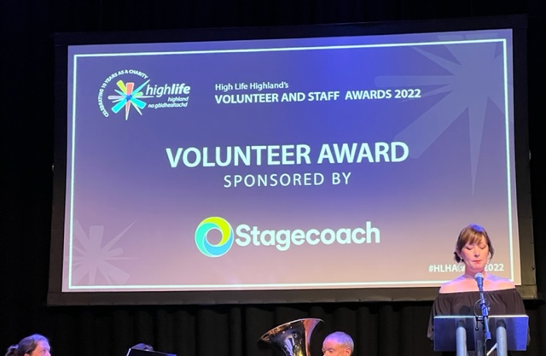
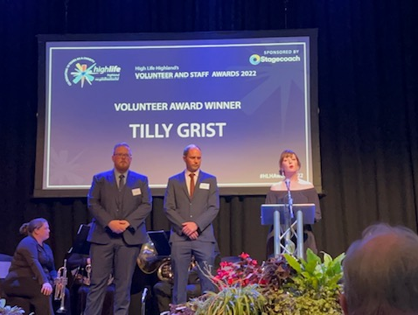
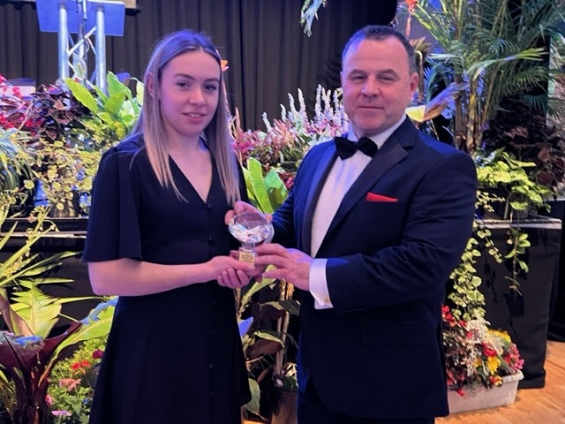
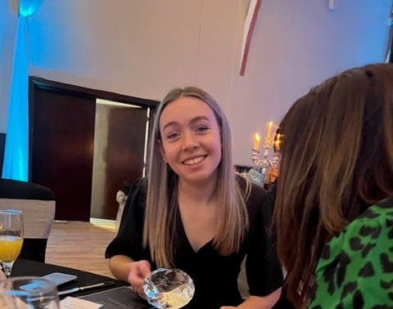

Slide 6
Creativity in Care Workshop
Great Creativity in Care Session with Karrie and Chris Unveiling our new Reflection Buddy Bench - designed by our young and older people at various sessions, created by Iain Chalmers at Chainsaw Creations. - filmed and was on the STV News 🎥📽 - https://fb.watch/g7ynaknTpM/
We were creating small puppet theatres for our paper puppets sitting on their own magical benches!
There was a deluxe buffet created and served by young people 👌😊

Slide 7
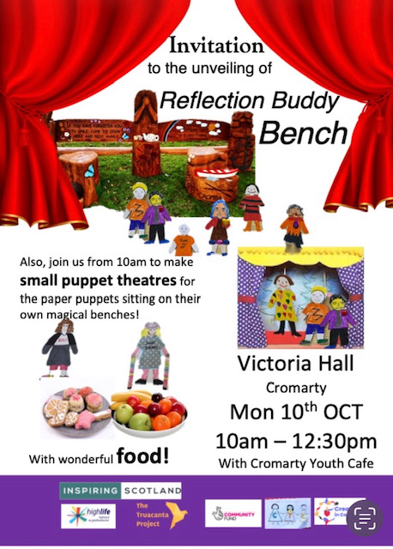
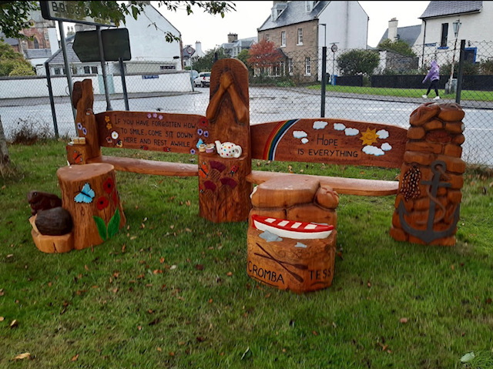

Slide 8
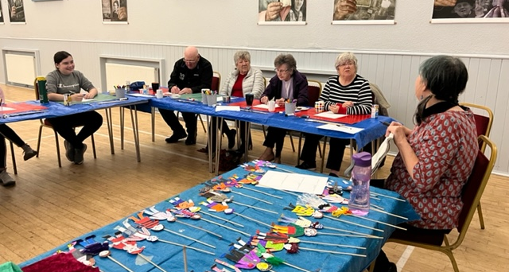
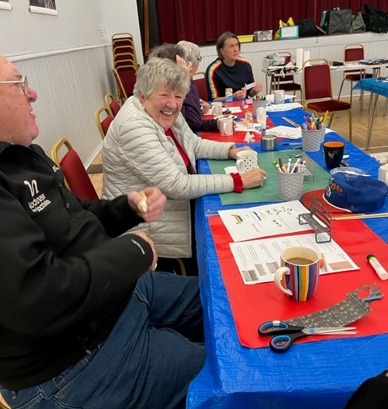
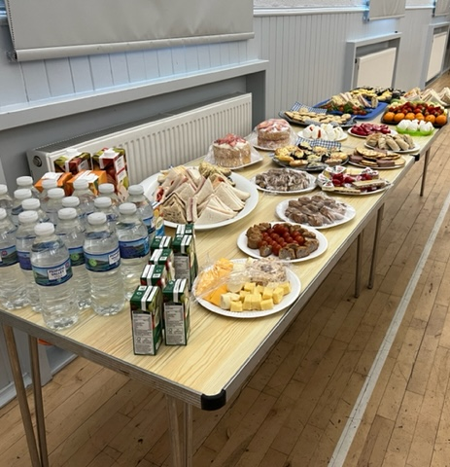
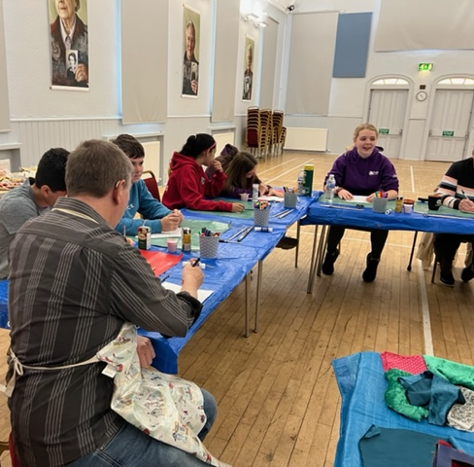

Slide 9
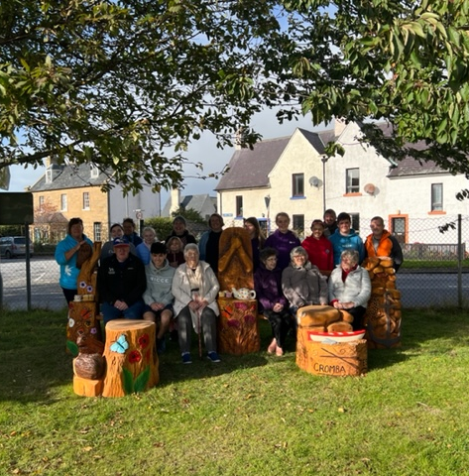
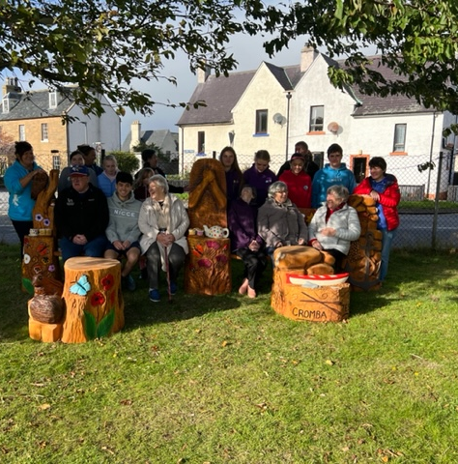

Slide 10
Graffiti Art Workshop with Local Artist Tommy
Young people learned how to design on a piece on paper, the various style options, paint control techniques for outline and fill in, colour choice and the various effects such as highlights, drop shadows and 3D by using Spray Paint,

Slide 11
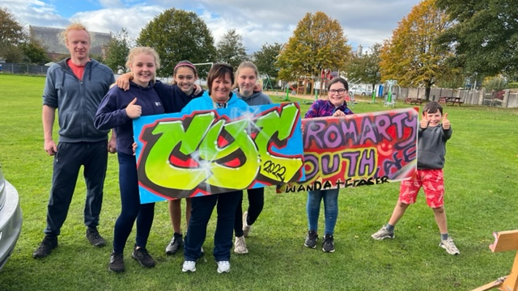

Slide 12
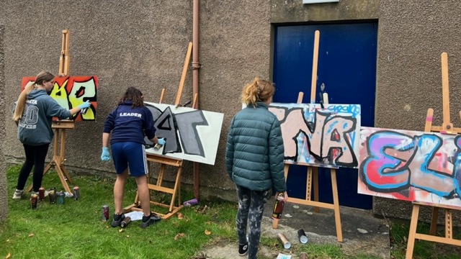
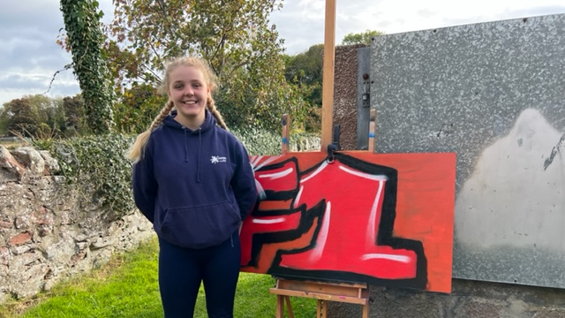
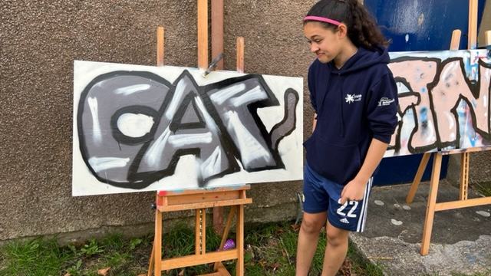
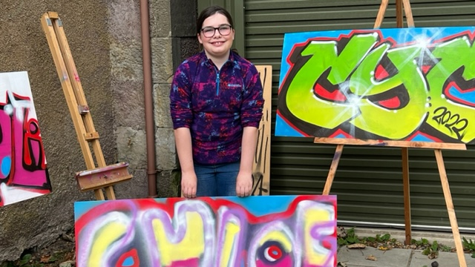

Slide 13
Inverness Caley Thistle Football Academy
The young people learned lots of new skills, Passing , Dribbling , Target practice and mini Games.

Slide 14
The Food
With the donation from Cfine and funding from MFR Cash for Kids & Food +, we have been able to deliver action packed exciting activities
Breakfast, Lunch, Dinner snacks & Picnics were provided at every activity daily.

Slide 15
Cookwell / Bakewell
This session was well attended:
Young people made:
Fiery Gingerbreads,
Mars Bar Krispies
Chocolate Cookies
Ginger Nut Cheesecakes
Home made Pizza’s
Swiss Roll
Selection of Toasties, Wrap & Bagels
Victoria Sponges

Slide 16
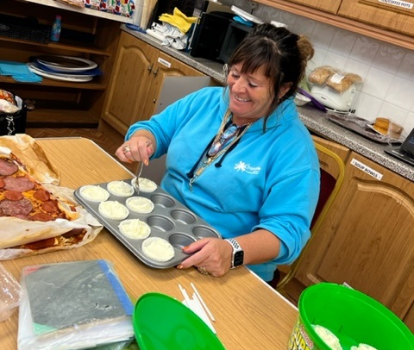
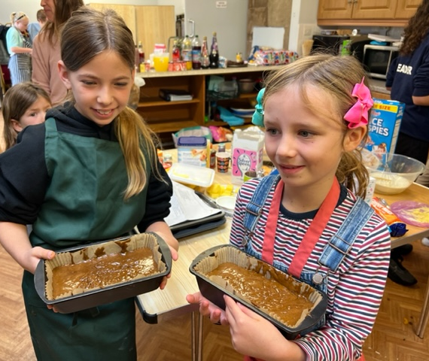
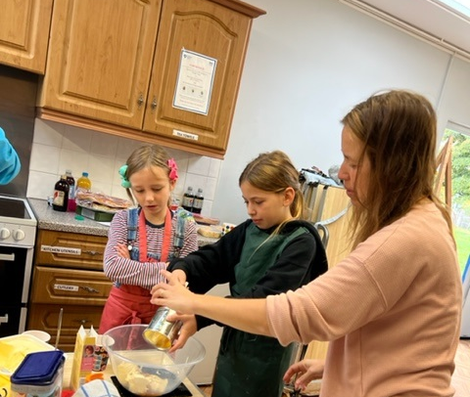
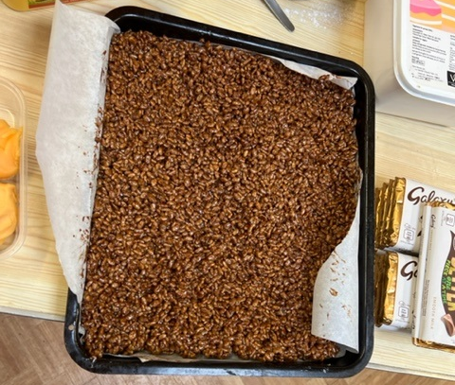
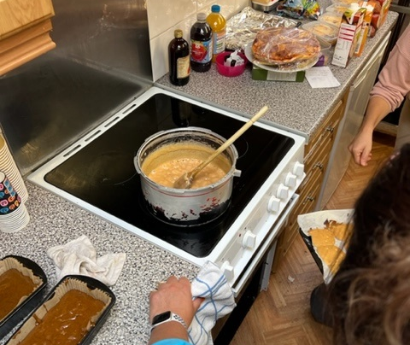
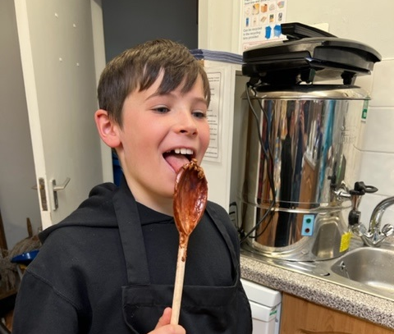

Slide 17
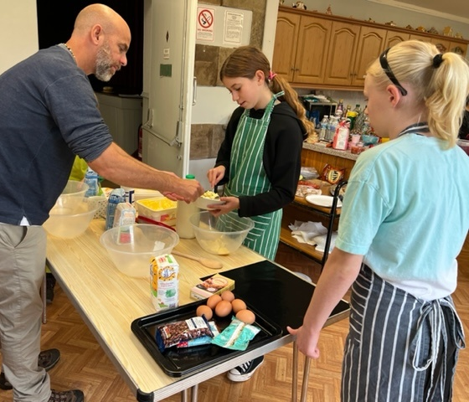
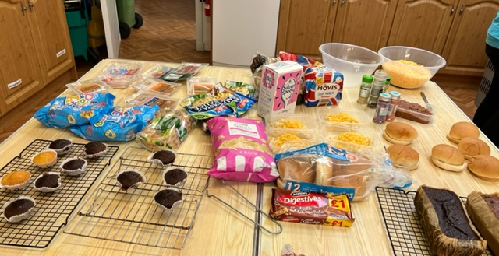
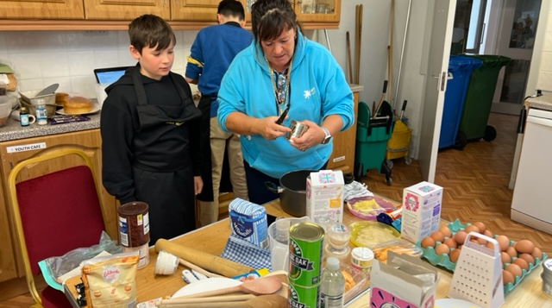

Slide 18
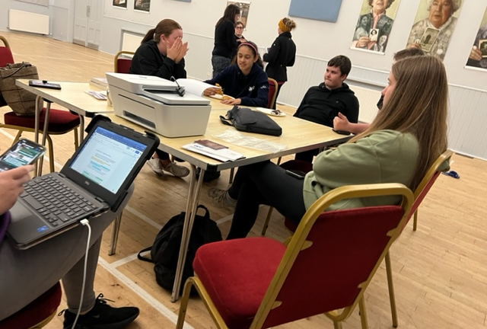
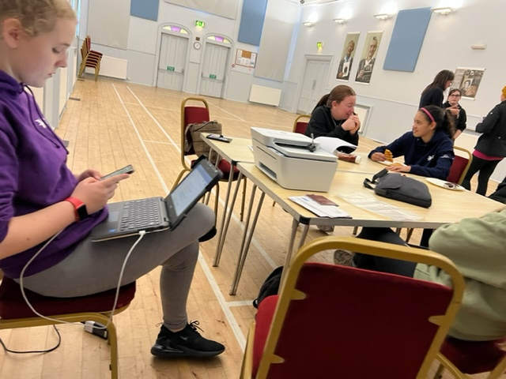
Signing up for the FREE Bus Pass
Huge thank you to Julie Macrae from Cromarty Community Development Trust for supporting young people and families to Sign up for Their FREE bus 🚌 travel card 👌😎
Yip we agree might be easier signing up 🆙 to the FBI 😉

Slide 19
Ease Course
In the Final session of the EASE Course we were talking about:
Bereavement –
How someone dying effects everyone differently.
Ways to cope when someone dies
Then we looked at self-care, and how to look after ourselves

Slide 20
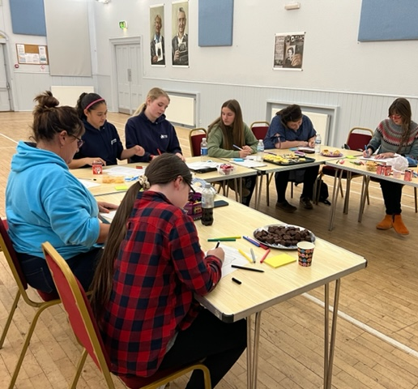
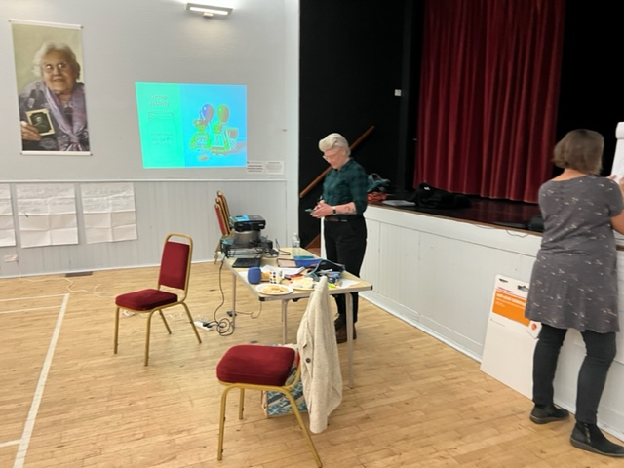
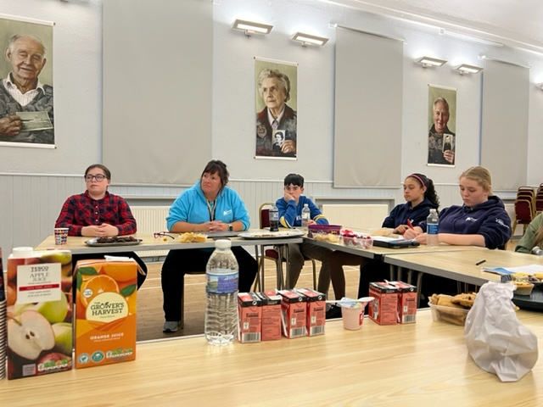

Slide 21
Youth Rowing
Each week we continue to take part in Youth Rowing,
Young people are becoming more experienced at sea, learning about wind, tides and weather
Young people are improving on their timing and form each week

Slide 22
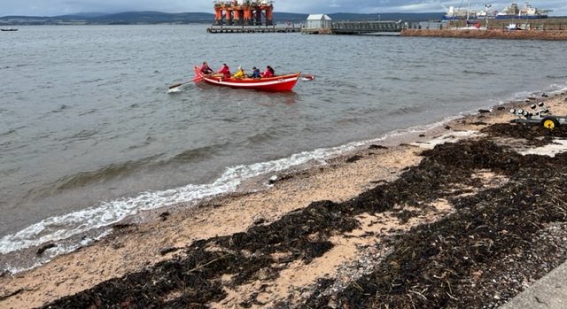
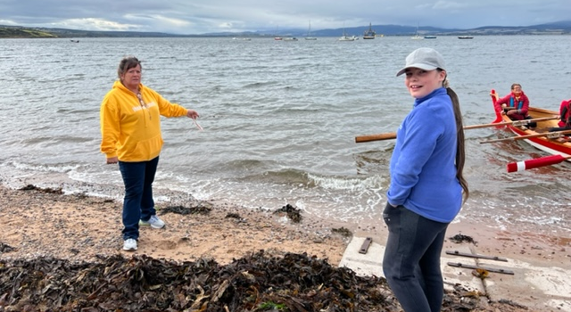
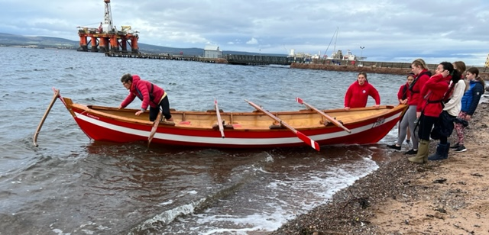
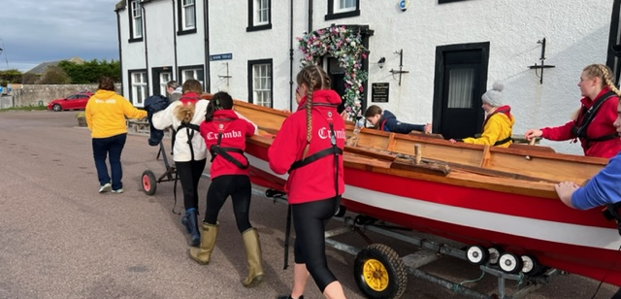

Slide 23
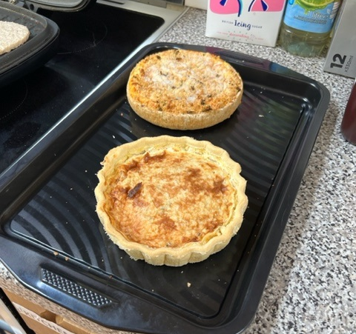
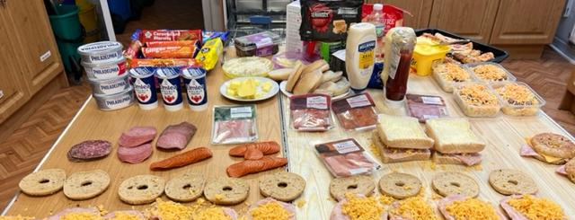
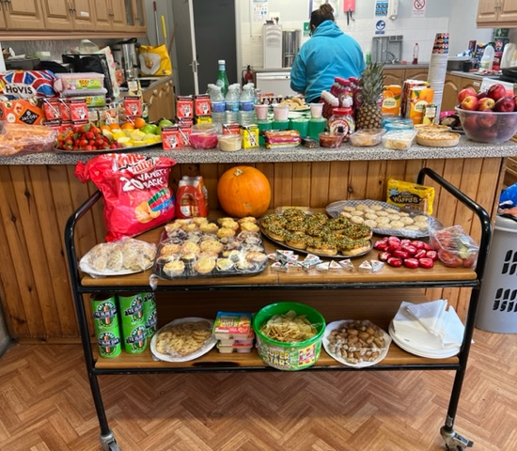
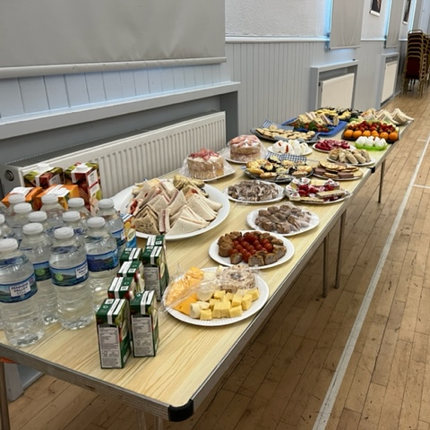

Slide 24
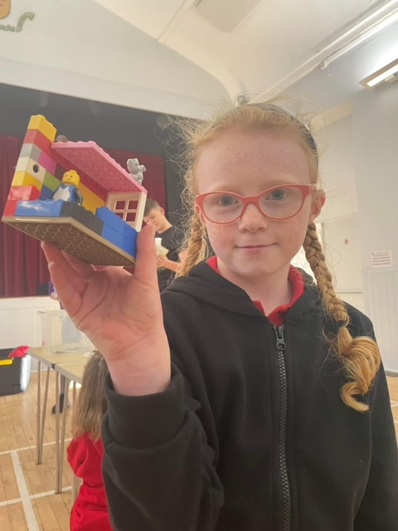
Lego Mania
At Junior Youth Café we had a Lego session,
Young people were asked to use their imagination to create a master piece

Slide 25
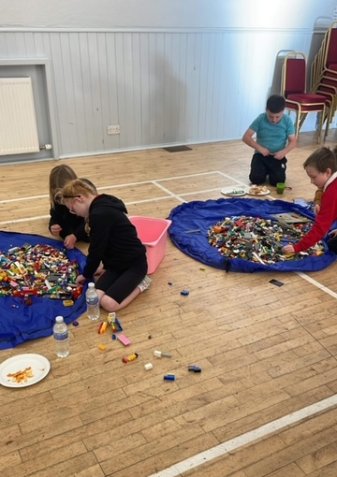
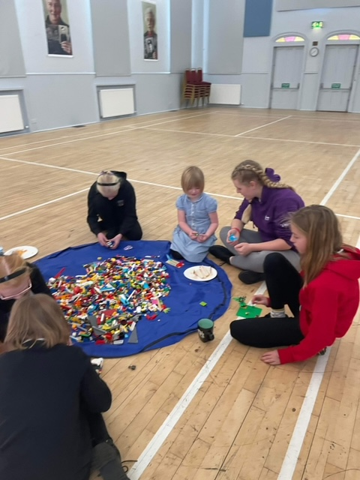
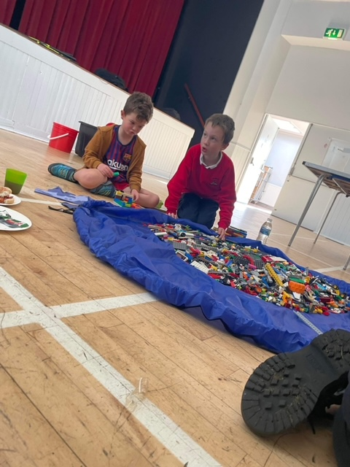

Slide 26
Saltire Awards & HLH Leadership Award
Over the last month we have been busy tracking and monitoring young people's achievements on either Saltire Awards, Highlife Highland Leadership Programme, or other courses.
A number of young people have signed up to the Choose to Lead Level 4 with Highlife Highland – this is an SQA recognised qualification

Slide 27
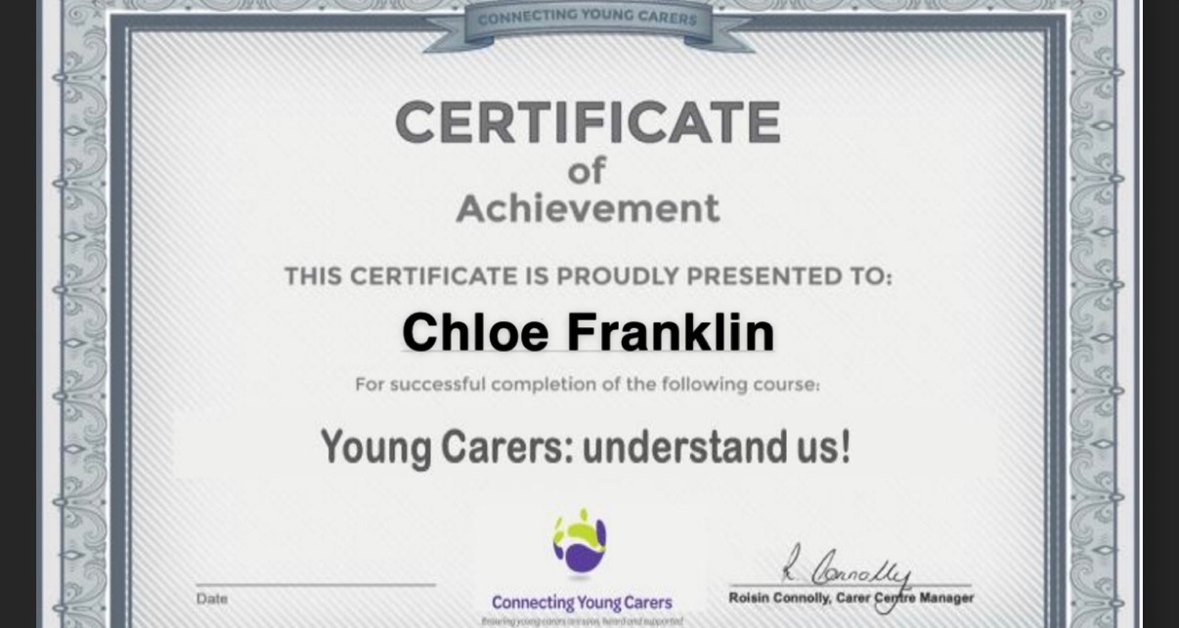
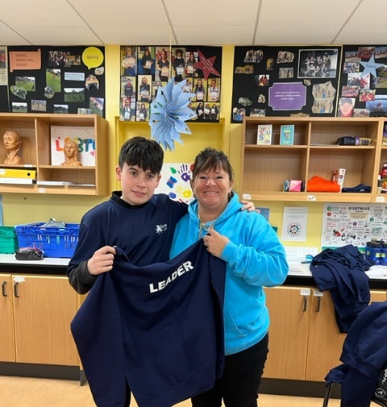
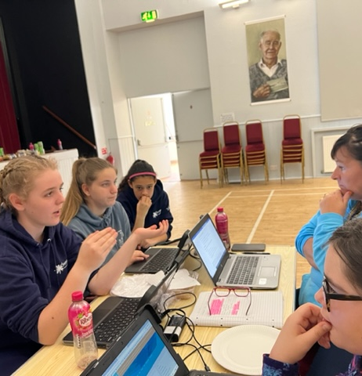
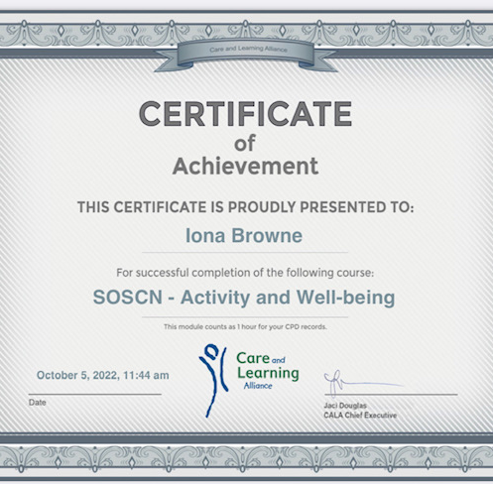

Slide 28
Staff, Young Saltire Volunteers & Highlife Highland Leaders
I would like to say a HUGE thank you to all the young volunteers / leaders who turned up to every activities to offer their supporting to deliver activity to other young people.
The biggest thank you goes to Wanda for her invaluable time, support and knowledge for supporting to run this programme and for finding the funding all year round for all our young people to be able to enjoy attending Youth Café and holiday programme activities.

